Slide 1
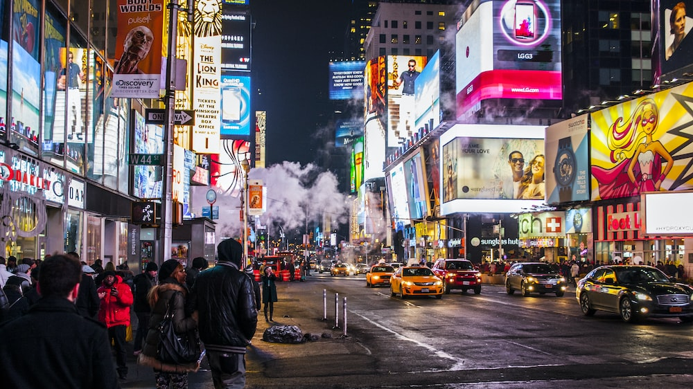

OOH
Activation
Rural
Retail
DOOH
A dentsu company
Posterscope
Mastering the art of impactful communication through strategic out-of-home advertising
A deep dive in our organization

Slide 2
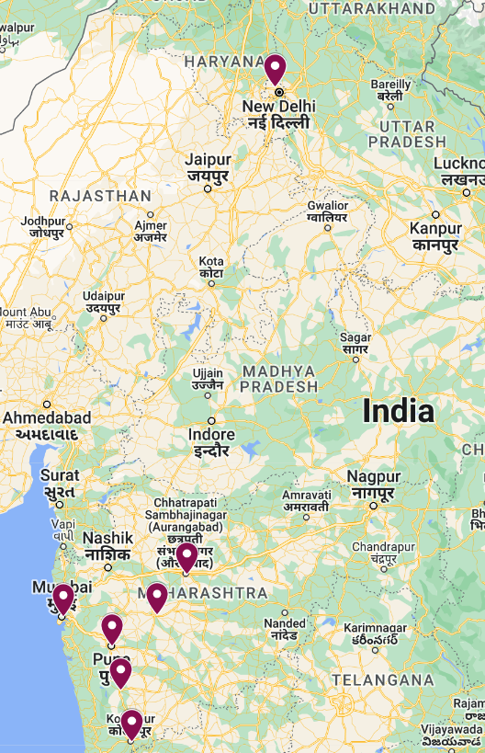
Oaksmith Style Studio Campaign
Campaign Understanding
Brand Name | Oaksmith
Sub Brand Name | Oaksmith Style Studio
Cities | Mumbai, Delhi, Pune, Kolhapur,Satara, Ahmednagar, Aurangabad
Caption/Communications | Style Studio
Media Type | Billboard, Digital Screen
Media Units | 71
Total Sqft | 62 K+ Sqft
Touch Point | High Impact Road, Key Arterial Road, Cinema Lobby
Total Spends | 20 Mn
Source: Times Monitoring and Market Intelligence

Slide 3
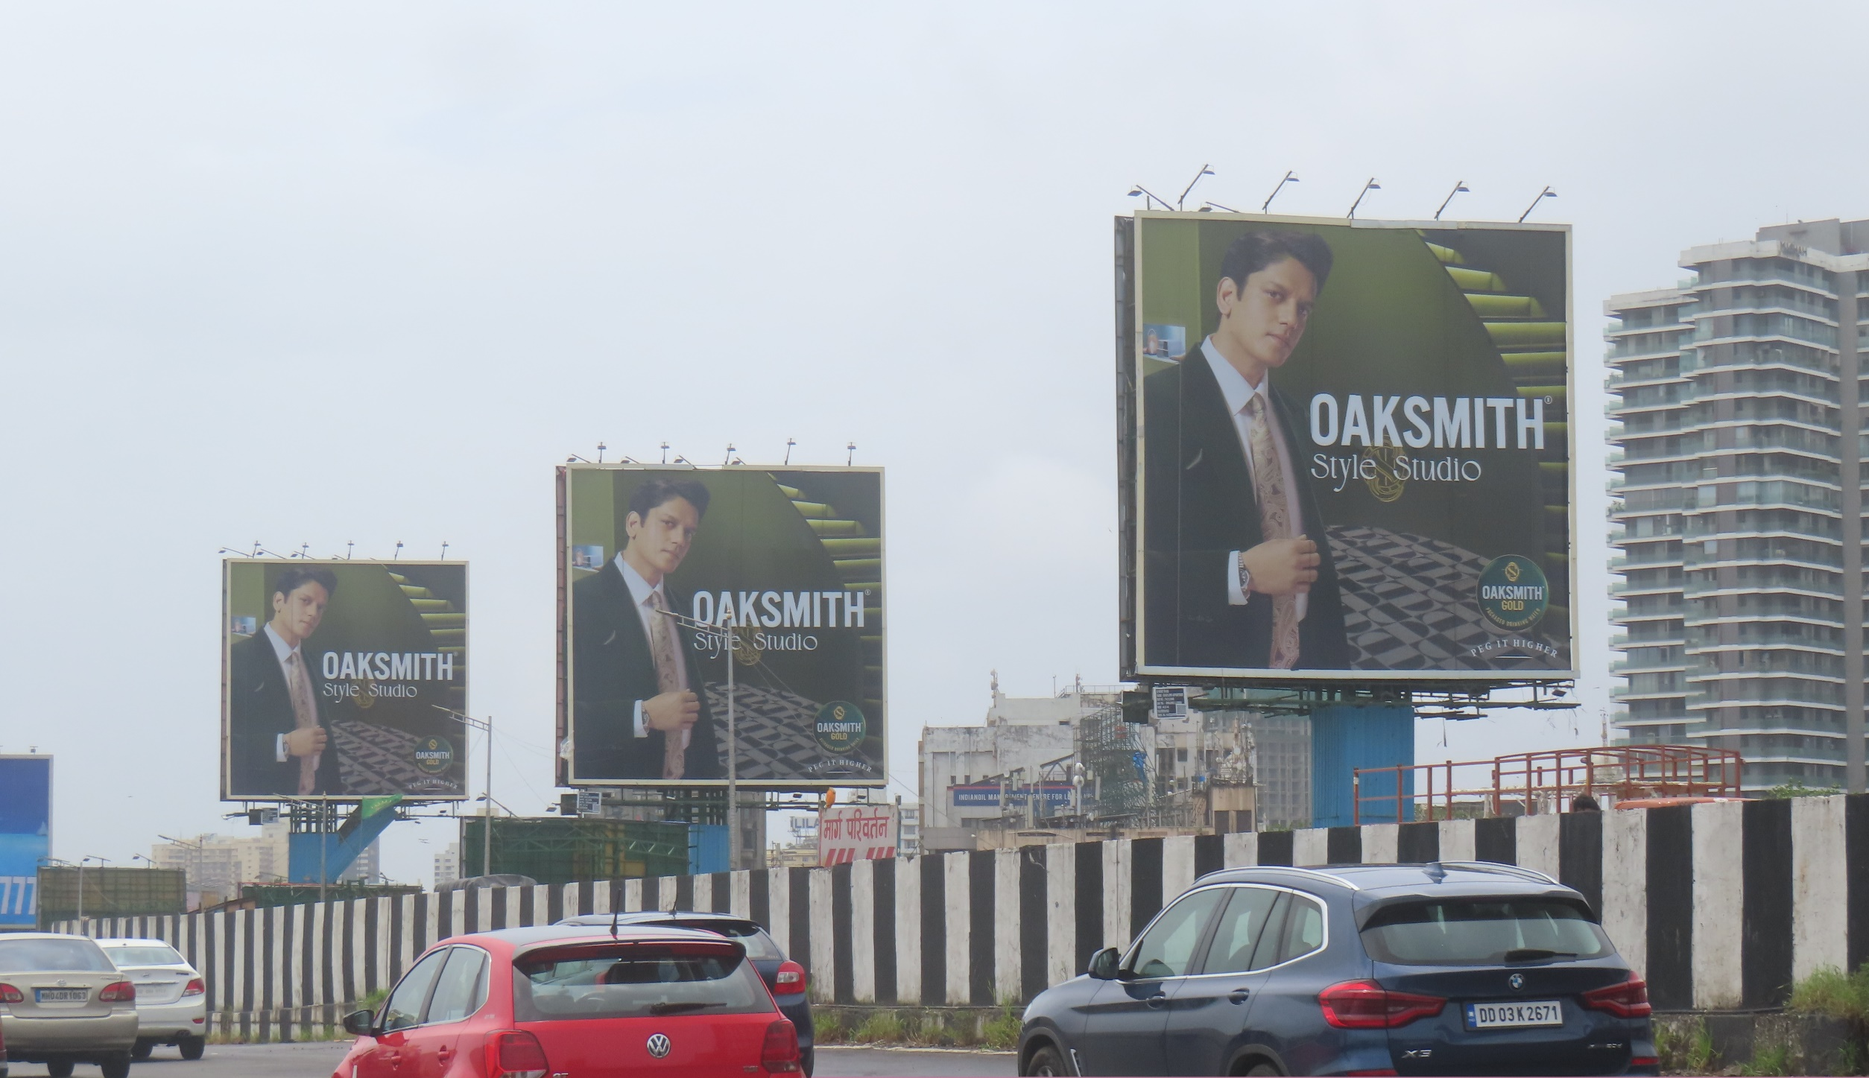
Oaksmith Style Studio Reference Photos

Slide 4
Competitor Analysis
In the liquor category, Seagram's leads in spending, followed by Oaksmith Gold and Teacher's, while other brands contribute at moderate levels.
Brands are primarily focusing on metro cities, with Mumbai accounting for 44% of the total spend, followed by Kolkata and Goa. Tier 2 cities like Bhubaneshwar, Guwahati, and Indore also see notable activity.
A mix of media formats is used, with Billboards being the most preferred (66% of the spend), followed by Unipole. Frequency media is also employed for brand recall.
Brands are highly active from March to May, with 43% of total spend concentrated in this period, while spending remains moderate in other months.
Source: Times Monitoring from Jan 2023 to July 2024

Slide 5

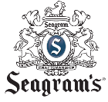




Monthly Seasonality and Category Understanding
Seagram's leads as the top spender in its category, with the highest of its investment They concentrated 55% of their investment in August, April, December, and March they strategically timed their campaigns for maximum impact. During these key months they partnered with celebrities for communications.
Oaksmith Gold is the second highest spender in its category, with its largest investment in March, covering 82% of its annual spend. They are partnering with an event featuring Rafael Cerato, a renowned electronic music artist. It enhances the brand's cultural appeal to an audience that values creativity, nightlife, and premium experiences.
Teachers is the third highest spenders in its category , with highest of its investment concentrated 57% in May and December. They partnered with rappers and Television host (Rannvijay Singh)
Other brand like All Seasons Club Soda is doing long term campaign focusing on versatility, adaptability, and reliability to excel in any situation or season, emphasizing consistency and relevance across different challenges.
Jim Beam blends smooth whiskey with the energy of live concerts and singer sessions, creating unforgettable, music-filled experiences. The brand focuses on elevating your moments with the perfect harmony of great taste and sound.
Other brands focus on live concerts, music shows, and draw attention with neon signs boards at high consumption city.
Source: Times Monitoring from Jan 2023 to July 2024

Slide 6
Top 10 Captions
No | Brand | Captions | Year | Spends In %
1 | Teachers | Buddy Vibes With Rannvijay Singha | 2023-2024 | 8%
2 | Jim Beam | Best Enjoyed Together | 2024 | 7%
3 | Teachers | Reserve Nights - Tech Panda X Kenzani | 2023 | 5%
4 | Teachers | The GQ 35 Most Influential Young Indians | 2024 | 5%
5 | Oaksmith Gold | This Holi Paint The Town With | 2023 | 4%
6 | All Seasons Club Soda | Man Of All Seasons | 2023-2024 | 4%
7 | Oaksmith Gold | Oaksmith Live Presents - Rafael Cerato | 2024 | 4%
8 | Jack Danielis | Labels We Are Given Ourselves | 2023 | 4%
9 | All Seasons Club Soda | Official Partner | 2024 | 4%
10 | Seagrams | Ab Har Koi Ban Sakta Hai Superstar | 2023 | 3%
Source: Times Monitoring from Jan 2023 to July 2024

Slide 7
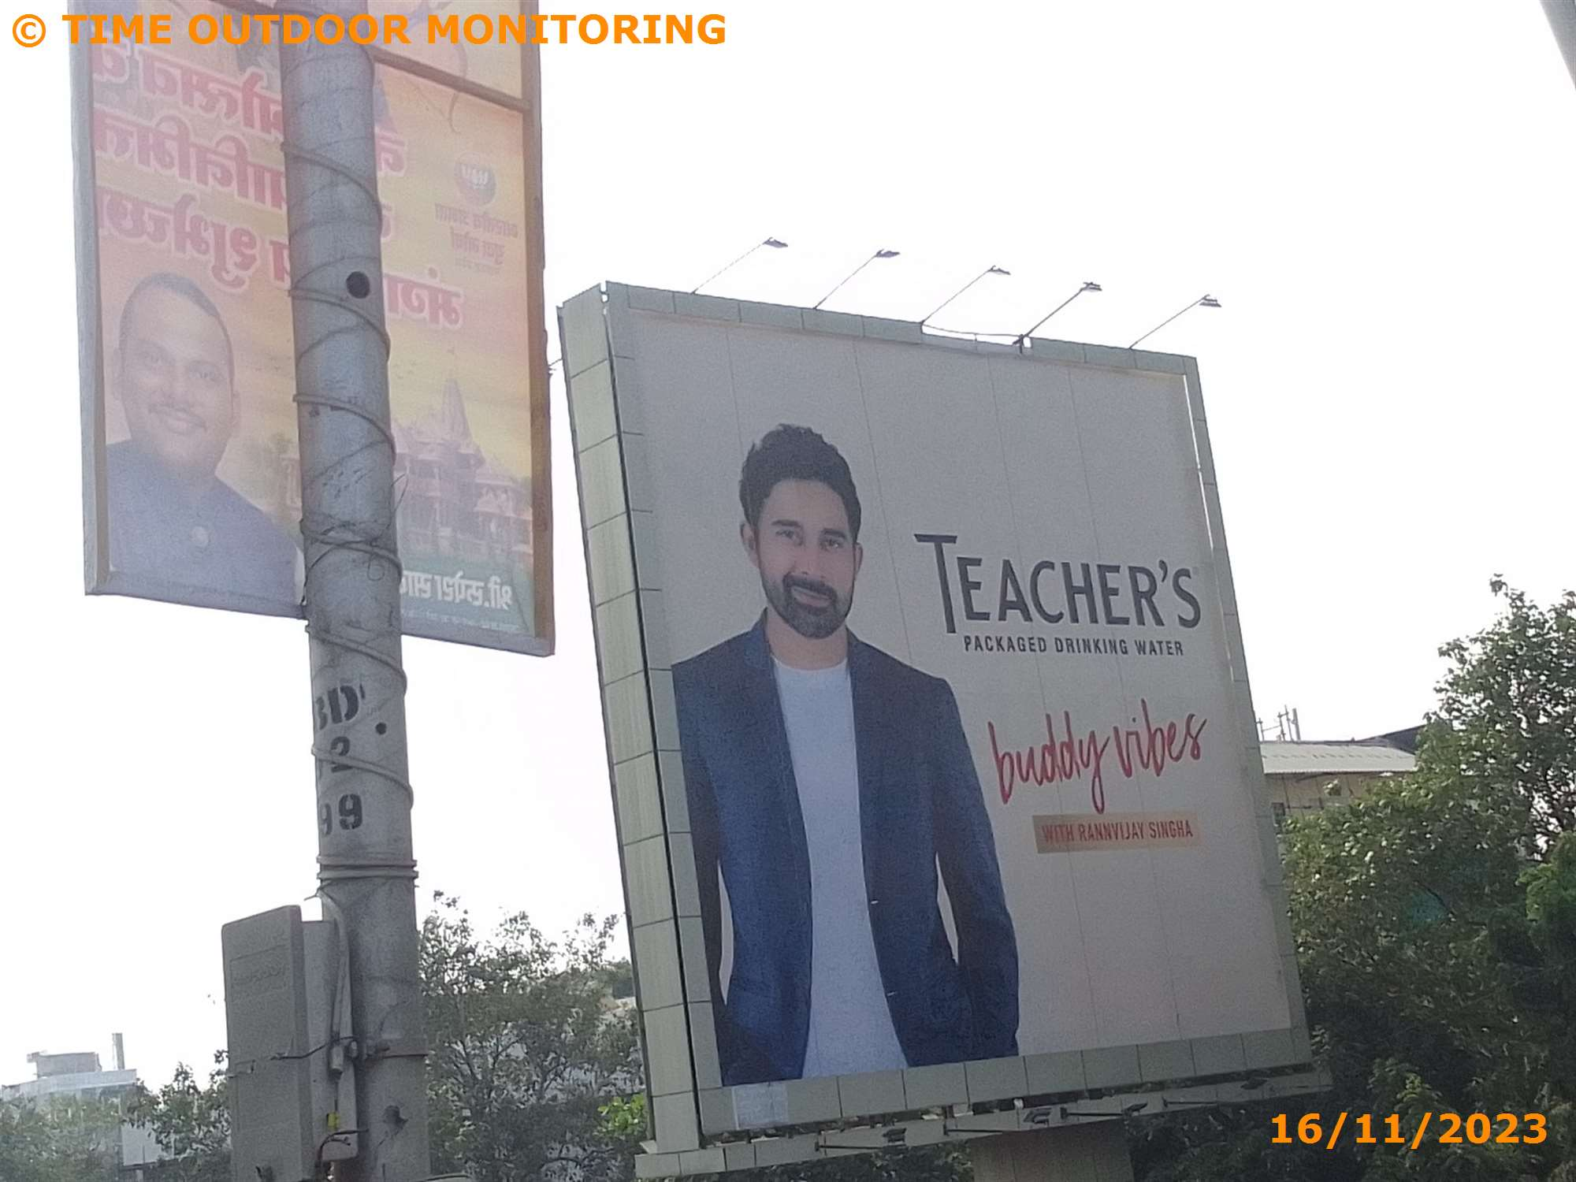
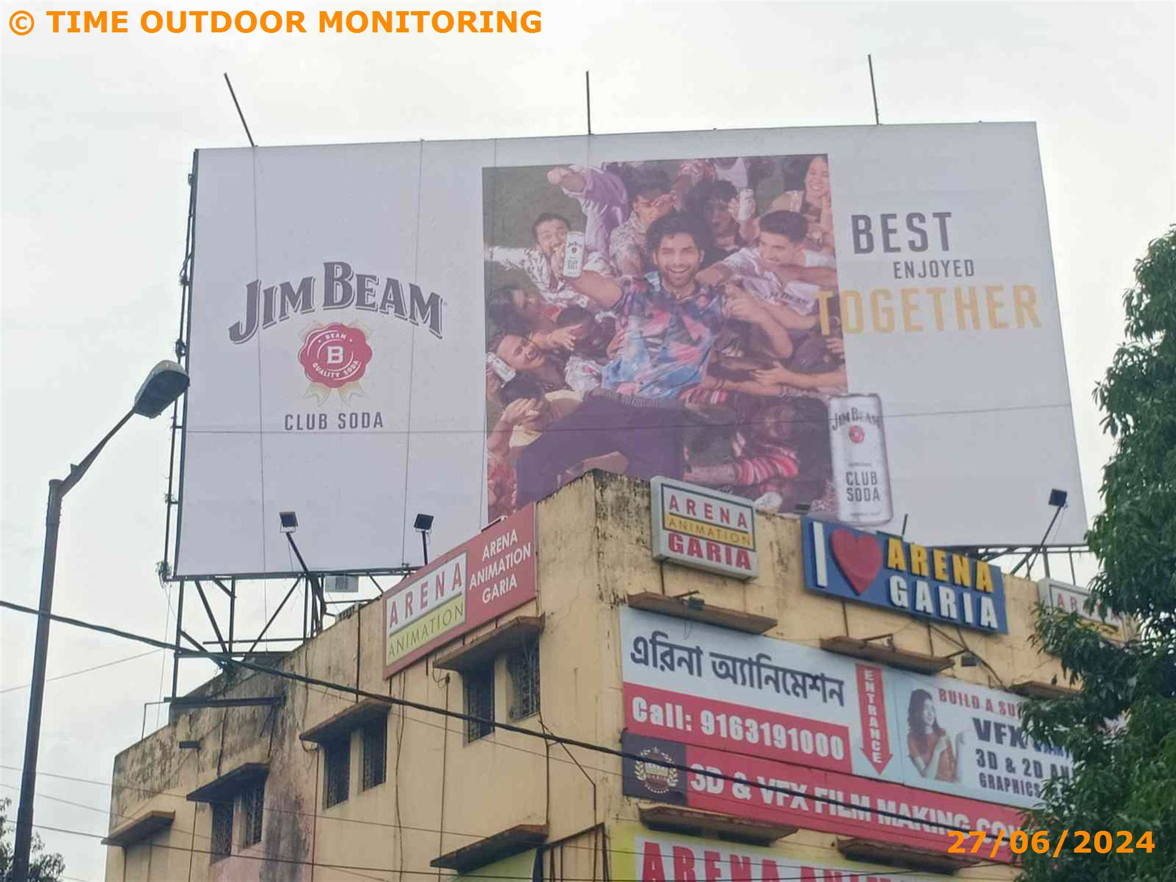
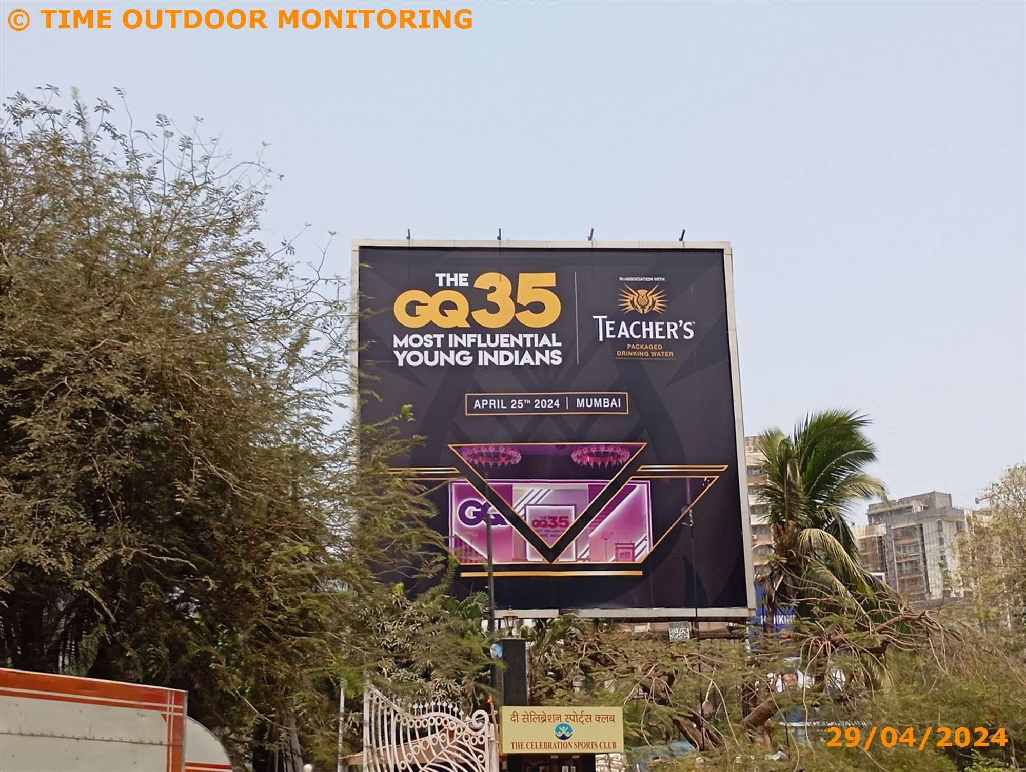
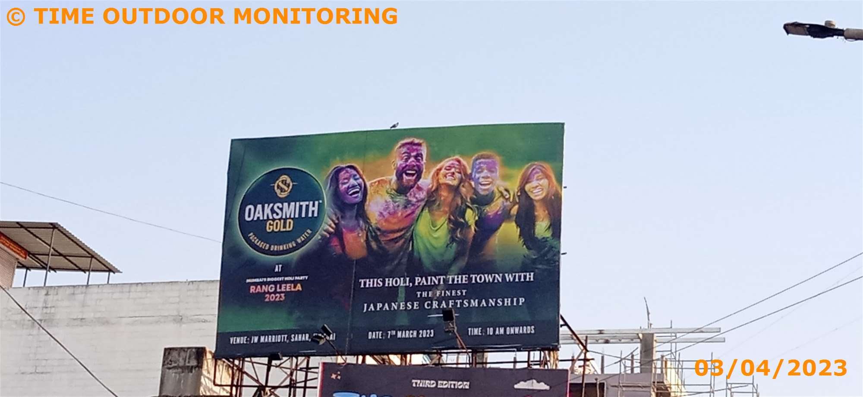
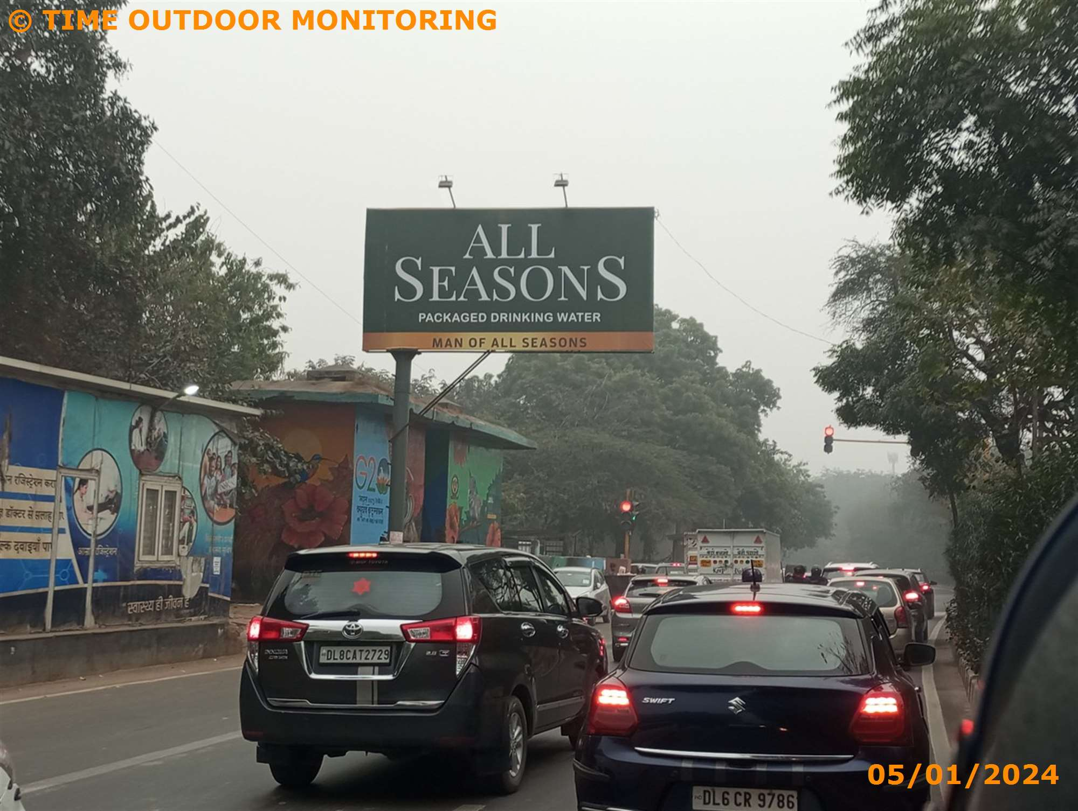
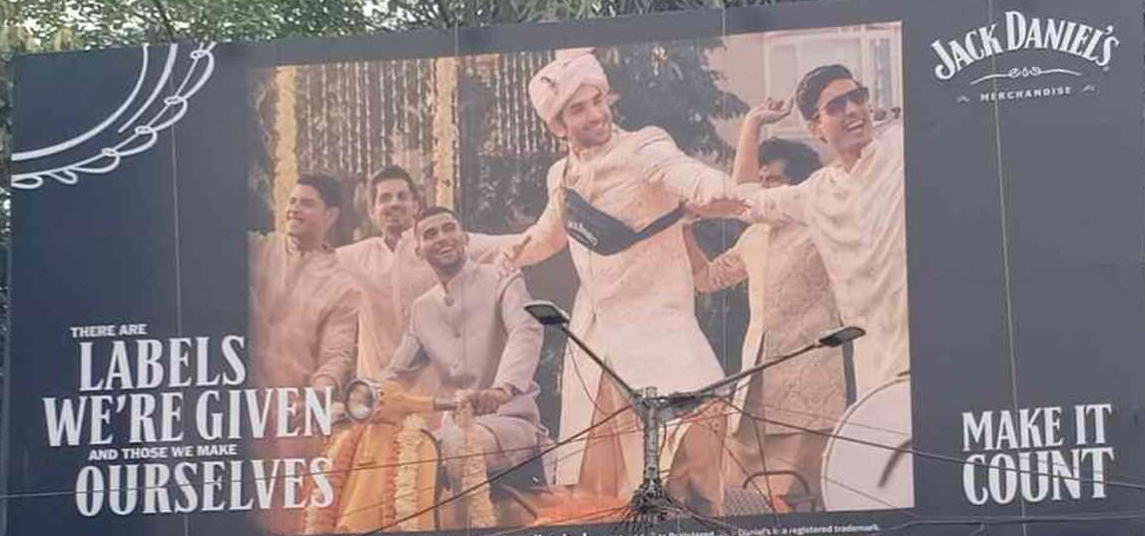
Captions Photos
Source: Times Monitoring from Jan 2023 to July 2024

